Slide 1
Plastic consumption
A comparison of benthic and pelagic fish from the River Thames collected 2014 – 2015

Slide 2
Contents
Background
Methods
Results
Conclusions and further research
Plastics as a global problem
Dissection
FTIR
Identification
Which species?
How many pieces were recovered?
From which sites?
Impacts
More sites

Slide 3
Background
2.5 billion tonnes of marine waste was produced in 2010 of which 99.5 million tonnes are plastic (Jambeck et al., 2015)
Negative impacts
Entanglement
Ingestion
Pollutant storage
Invasive species transport
693 species (Gall & Thompson, 2015)
92% of the individual organisms ingested plastic pieces.
Microplastics <5mm

Slide 4
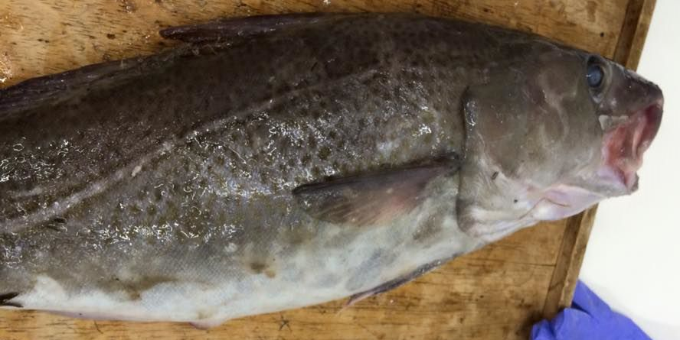
Samples
3 locations in the Thames
10 species so far
Flounder
Sole
Dab
Dogfish
Whiting
Pouting
Roker (rays)
Gurnard
Shrimp
Cod

Slide 5
Methods
Dissection
Searching gut contents
FTIR analysis
Identification

Slide 6
Fourier Transform Infra-red Spectroscopy

Slide 7
Identification
Organic?
Synthetic?

Slide 8
Results
Plastic is ingested by 4 species.
Flounder
Whiting
Cod
Shrimp
81 fish have been dissected.
50 have undergone gut exploration, but only from Southend and Erith.
27 have gone onto FTIR analysis.
44.4% had ingested plastic.
9.7% of shrimp ingested plastic.

Slide 9
Results
Erith flounder
7 colours.
10/12 ingested fibres.
Clear fibres are the most abundant.
60.2%
Clear
Black
Green
Red
Blue
Brown
Clear/green

Slide 10
Results
Erith flounder
Most fibres removed from the gut are damaged prior to FTIR analysis, lost or produce spurious results.

Slide 11
Results
Erith flounder
Spurious and organic removed.
Clear still most abundant.

Slide 12
Results
Erith flounder
Polyester is the most common type of plastic fibre.
38.1%

Slide 13
Conclusions
Plastics of anthropogenic origin are ingested by estuarine organisms.
Fibres originate from washing machines.
Fishing could impact plastic pollution.
Plastics are ingested by both predator and prey species.
Prey have ingested less plastic than predators.
Further research is needed into:
The effects of plastics once ingested.
Whether plastics or chemicals can be transferred to humans and the impacts that could incur.

Slide 14
What’s next?
Continue dissection and analysis of current samples.
Collect samples from Clyde Sea.
Comparison of the River Thames and Clyde Sea.

Slide 15
Questions?
Thank you for listening.
Thank you to Dr Morritt, supervisor; Dr Clark, NHM; and Dr McEvoy, FTIR.

