Slide 1
Long cycles in expanding graphs, with applications
Michael Krivelevich
Tel Aviv University

Slide 2
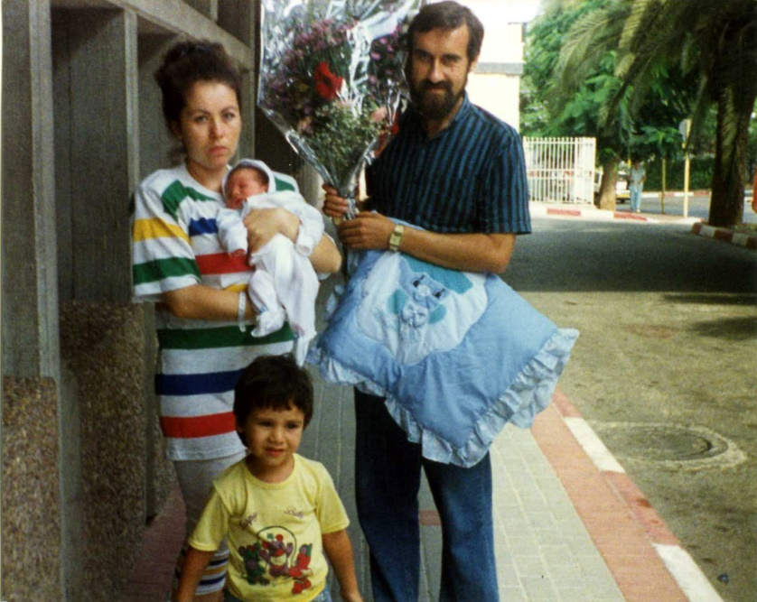
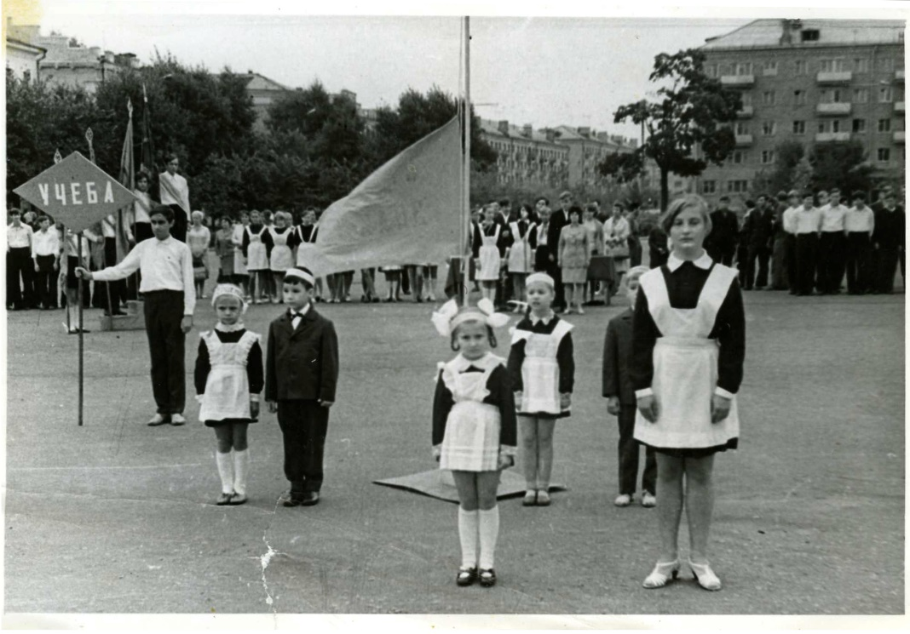
Grisha Gutin and me…
List of PhD students of Noga Alon at Tel Aviv U. (1985-present):
1. Y. Azar (graduated 1989)
2. U. Zwick (graduated 1989)
3. G. Gutin (graduated 1993)
4. R. Yuster (graduated 1994)
5. M. Krivelevich (graduated 1997)
6. B. Sudakov (graduated 1999)
….
22. O. Ben-Eliezer (in progress)

Slide 3
Local expanders
Notation: $G=(V,E)$ – graph, $W⊂V$ – vertex subset
$N_{G}(W)≔\{v∈V∖W:v$has a neighbor in $W\}$
– external neighborhood of $W$
Def.: $G=(V,E)$ – graph, $k$ – integer, $α>0$ – real
$G$ is a $(k,α)$-expander if
$$\left|N_{G}\left(W\right)\right|≥α\left|W\right|, ∀W⊂V, \left|W\right|≤k$$
(Think of $k=cn, n=\left|V\right|, α>0$ – small constant)

Slide 4
Main question
Q.: $G \text{− }(k,α)\text{−}\text{expander}$. Longest cycle in $G$?
somewhat (…) studied;
corresponding question for paths (=longest path in
a $(k,α)\text{−}\text{expander}$) – more studied question
can expect some difference between paths and cycles
potential applications: extremal problems, Ramsey-type settings, random graphs, positional games,…
(some details/examples – later)

Slide 5
Known results
Brandt, Broersma, Diestel, Kriesell’06:
$G\text{ − }(k,α)\text{−}\text{expander}$, $α≥2$
$⇒ G$ contains a cycle of length $≥\left(α+1\right)k$
Proof: adaptation of Pósa’s rotation-extension technique
(assumption $α≥2$ – essential there)
Smaller $α$? $α=0.001?$ – very different regime…

Slide 6
Main technical tool
“A simple but powerful lemma”…
Lemma: $G$ – connected graph.
There exists a rooted spanning tree $T$ of $G$ s.t.
$∀e=\left(u,v\right)∈E\left(G\right)∖E(T)⇒$ one of $\{u,v\}$ is an ancestor of the other along $T.$
Proof: Run Depth First Search (DFS) algorithm on $G$ to get $T$
(based on any order $σ$ of $V(G))$. $∎$
Idea to be used later: a long backward edge of $E\left(G\right)∖E(T)$ produces a long cycle.

Slide 7
Cycles in local expanders
Th. 1: $G$ – $(k,α)$-expander on $>k$ vertices
$⇒$ $G$ has a cycle of length $≥ \frac{αk}{2}$ .
Tightness: $α≤1, G=K_{k,αk}$.
Longest cycle in $G:$ $2αk$ vertices.

Slide 8
Cycles in local expanders
Th. 1: $G$ – $(k,α)$-expander on $>k$ vertices
$⇒$ $G$ has a cycle of length $≥ \frac{αk}{2}$ .
Proof: (partly in cooperation with N. Alon)
1. $G$ has a conn. comp. $C$ of size $\left|C\right|>k$
2. $T$ – result of DFS applied to $(C,σ)$
3. Find $v∈V\left(T\right), X⊂V(T)$ – subset of children of $v$ s.t.
$\frac{k}{2}≤\left|∪\left\{subtrees rooted at X\right\}\right|≤k$
$$Go down the tree$$
till find lowest $v$ s.t.
|subtree($v$)|$>k;$
Look right under $v$
$$W$$

Slide 9
Cycles in local expanders (cont.)
4. $P$ – path from root $r$ of $T$ to $v$
Property of DFS $⇒N\left(W\right)⊆V(P)$
$\frac{k}{2}≤\left|W\right|≤k ⇒\left|N\left(W\right)\right|≥\frac{αk}{2}$.
$v^{∗}∈N\left(W\right)∩P$ - farthest from $v$
vertex on $P$;
$w∈W$- its neighbor.
Cycle: $w\overset{→}{W } v\overset{→}{P}v^{∗}w$ - of length $≥\left|N\left(W\right)\right|≥\frac{αk}{2} . ∎$
$$r$$
$$P$$
$$v^{∗}$$
$$C$$
$$v$$
$$w$$
$$W$$

Slide 10
Long cycles in locally sparse graphs
Th. 2: $c_{1}>c_{2}>1$, $k$ – positive integer.
$G=\left(V,E\right)$ has the following properties:
$\left|E\right|≥c_{1}|V|$ ; (=average degree $≥2c_{1}$)
$∀ R∈V, \left|R\right|≤k, { e}_{G}\left(R\right)≤c_{2}|R|$. (locally sparse)
Then $G$ has a cycle of length $≥\left(\frac{k}{2}−1\right)\left({\left(\frac{c_{1}}{c_{2}}\right)}^{1/2}−1\right)+1.$
Conclusion: $c_{1},c_{2}= Θ\left(1\right)⇒$ get a cycle of length $Θ(k)$.

Slide 11
Where do locally sparse graphs come from?
from random graphs naturally:
$G\left(n, \frac{c}{n}\right), c>1,$ is with high prob. (whp) locally sparse.
Prop: $c_{1}>c_{2}>1$– constants. Define: $δ={\left(\frac{c_{2}}{5c_{1}}\right)}^{\frac{c_{2}}{c_{2}−1}}$.
$G∼G\left(n,\frac{c_{1}}{n}\right)$ is whp s.t.
every k$≤δn$ vertices span $≤c_{2}k$ edges.
Proof: straightforward first moment/union bound:
$\operatorname{Pr}\left[∃ a violating set\right]≤\sum_{k≤δn}{\left(\begin{matrix}n \\ k\end{matrix}\right)\left(\begin{matrix}\left(\begin{matrix}k \\ 2\end{matrix}\right) \\ c_{2}k\end{matrix}\right)p^{c_{2}k}=…=o\left(1\right)}$ . $∎$

Slide 12
Applications
Long cycles in subgraphs of sparse random graphs
Th. (Ajtai, Komlós, Szemerédi’81):
$G∼G\left(n,\frac{1+ε}{n}\right)$, $ε>0$ – constant, whp contains
a linearly long cycle.
[Simple(r) proof, right dependence on $ε$ – K., Sudakov’13]
Proof: Look at the giant component $R$ of $G$:
whp: 1. $\left|R\right|=Θ\left(n\right)$;
2. $\frac{e(R)}{|R|}≥1+δ,$ $δ=δ\left(ε\right)>0$ (positive relative excess);
3. $G\left[R\right]$ – locally sparse
$⇒G\left[R\right]$ spans a linearly long cycle ($⇐$Th. 2). $∎$

Slide 13
Applications
Multi-color size Ramsey numbers of paths
Notation: $G,H$ –graphs, $r≥2$ – integer.
$G→{(H)}_{r}$ if any $r$-coloring of $E(G)$ produces
a monochrom. copy of $H$.
Def.: $r$-color size Ramsey number of $H$
$\hat{R}\left(H,r\right)=\min{\{|E\left(G\right)|: }G→{(H)}_{r}$}.
Size Ramsey numbers of paths:
Beck’81: $\hat{R}\left(P_{n},r\right)=Θ_{r}\left(n\right).$
Q.: Dependence on $r$?

Slide 14
Multi-color size Ramsey numbers of paths
Dudek, Prałat’16+:
Lower bound: $\hat{R}\left(P_{n},r\right)=Ω\left(r^{2}\right)⋅n$;
Upper bound: $\hat{R}\left(P_{n},r\right)≤33r4^{r}⋅n$.
Th. 3: $\hat{R}\left(P_{n},r\right)≤r^{2+o\left(1\right)}⋅n.$
Proof: Look at $G∼G\left(n,\frac{Cr}{n}\right)$.
For any $r$-coloring of $E(G)$:
Show that a majority color has a cycle /path of length
$≥{\left(\frac{1}{400r}\right)}^{\frac{C}{C−4}}⋅n$ ($⇐$ Th. 2). $∎$

Slide 15
Open (meta-)question
Q: Analogous results for directed graphs?
Out-expansion of sets up to $k⇒$ cycle of length $Ω(k)$?
Some preliminary results available…

Slide 16
Happy 60th birthday, Gregory!

